Slide 1
NERD: NEURAL FIELD-BASED DEMOSAICKING
Tomas Kerepecky†∗ , Filip Sroubek† , Adam Novozamsky†, Jan Flusser†
†The Czech Academy of Sciences, Institute of Information Theory and Automation, Prague, Czechia ∗Faculty of Nuclear Sciences and Physical Engineering, Czech Technical University in Prague, Czechia

Slide 2
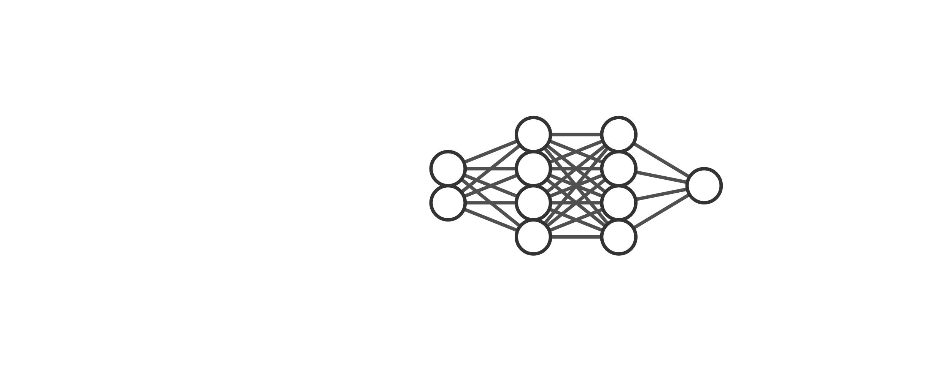
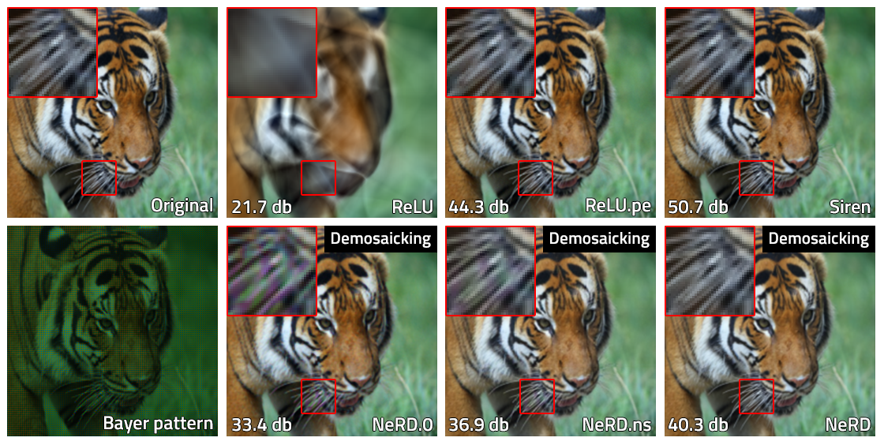
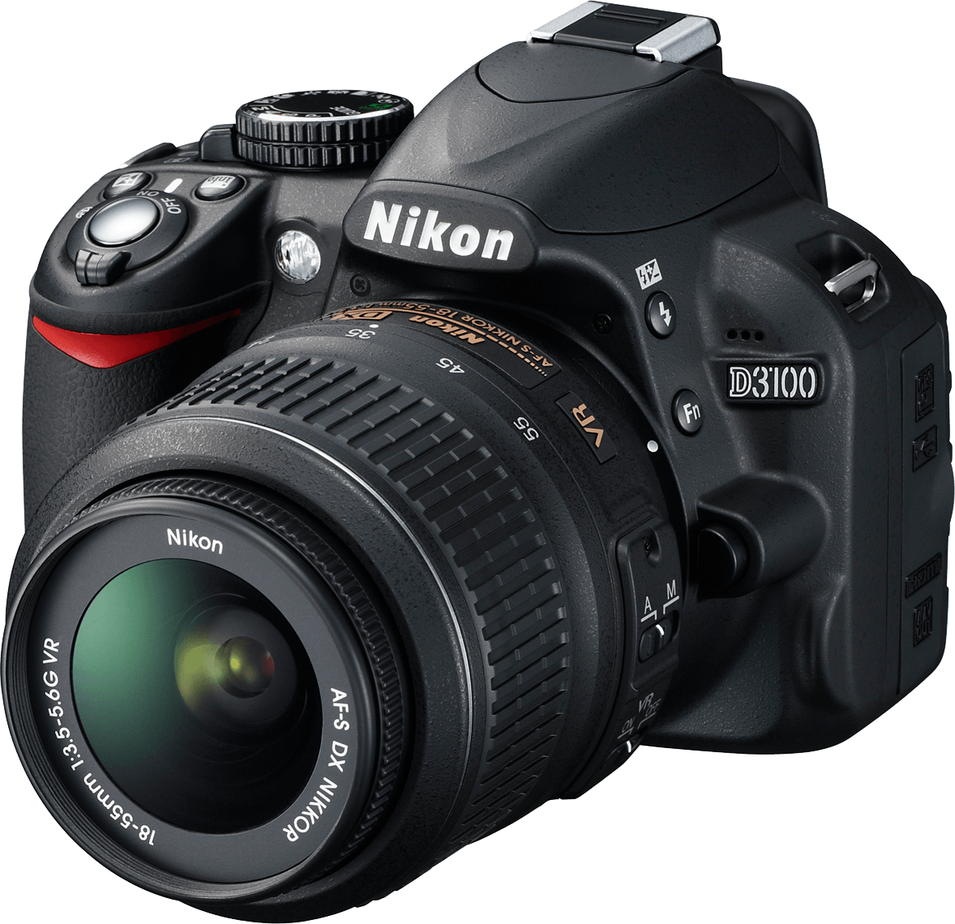
Problem formulation
Image acquisition
Demosaicking

Slide 3
Problem formulation
First neural field-based demosaicking!
Image acquisition
Demosaicking

Slide 4
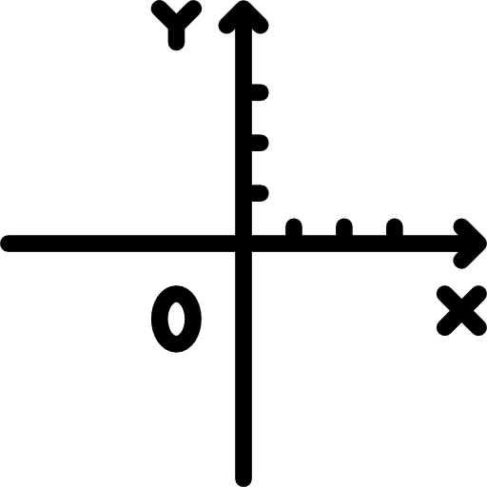

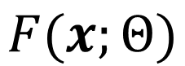
Neural Field
MSE
$$F(x;Θ)$$
Output
Original

Slide 5
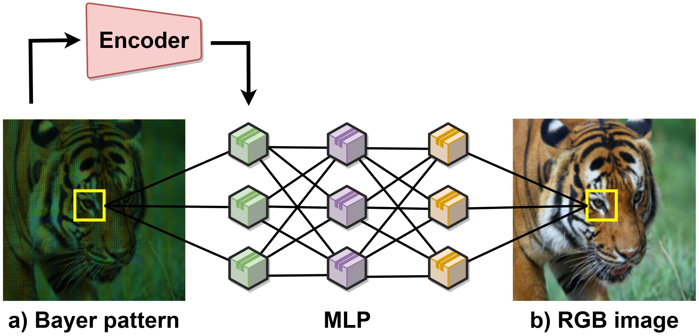
NeRD: Neural field-based Demosaicking

Slide 6
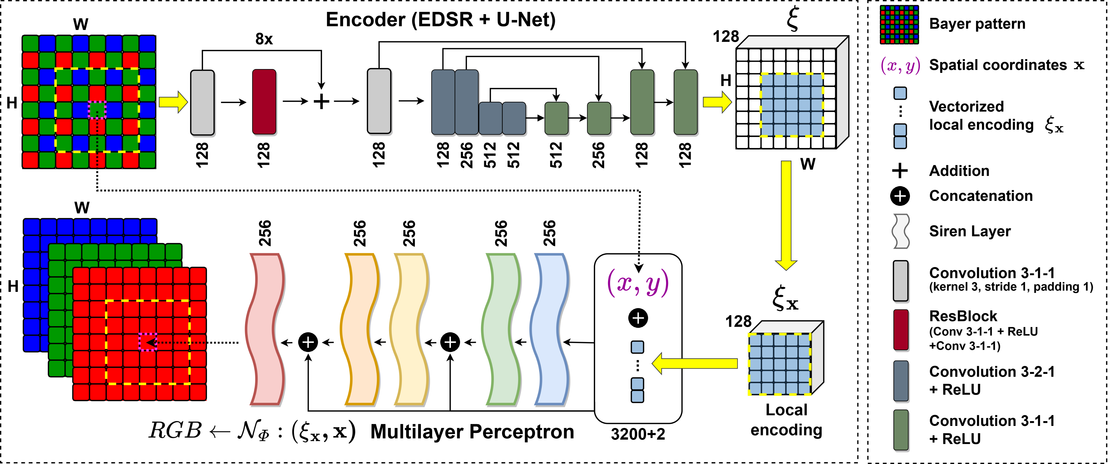
NeRD Framework

Slide 7
NeRD Framework

Slide 8
NeRD Framework

Slide 9
Ablation Study

Slide 10
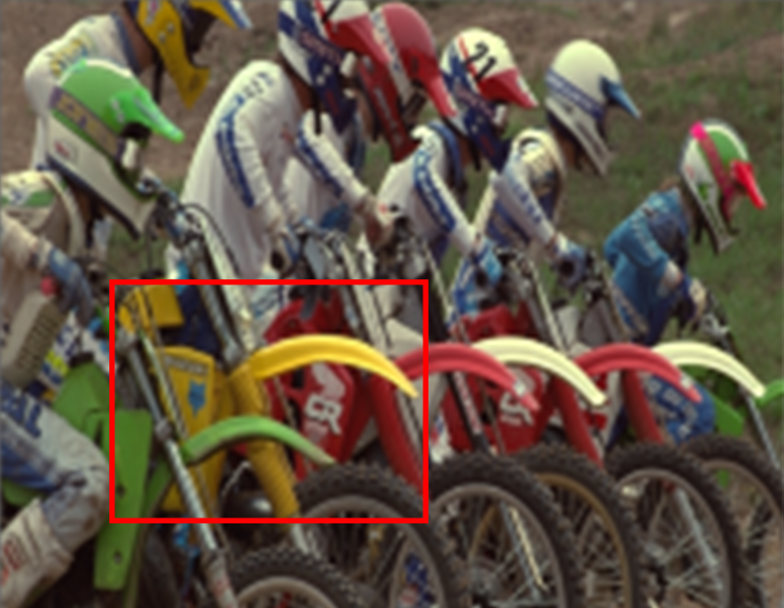
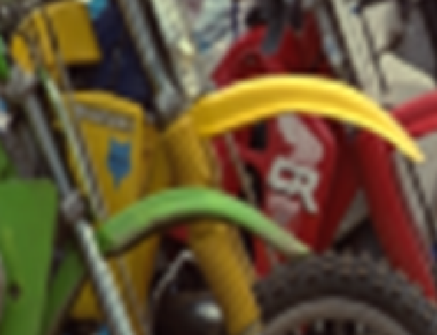

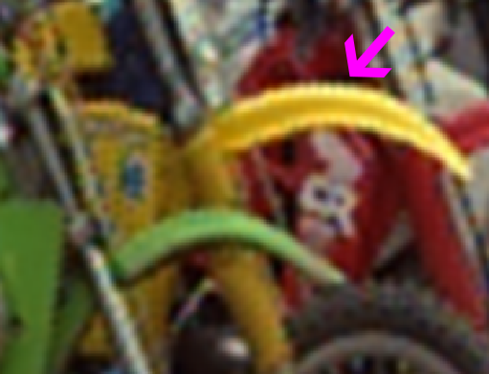
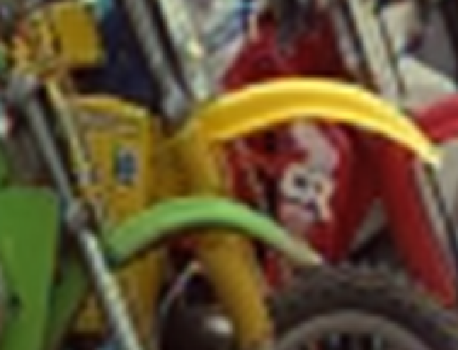
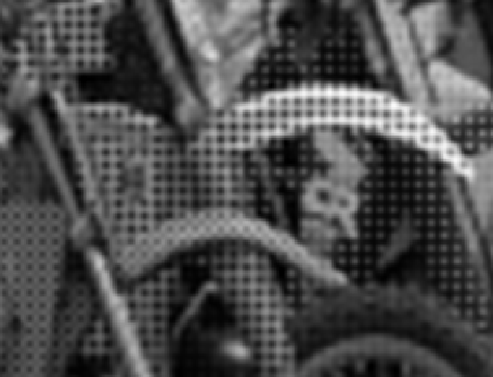
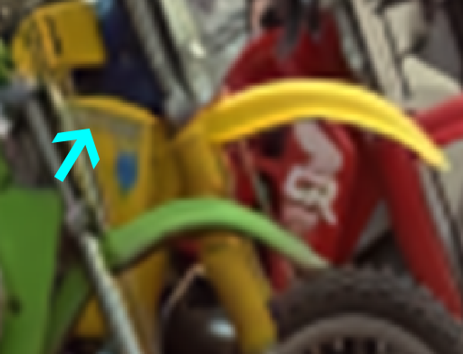

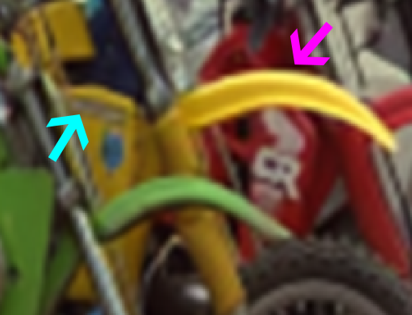
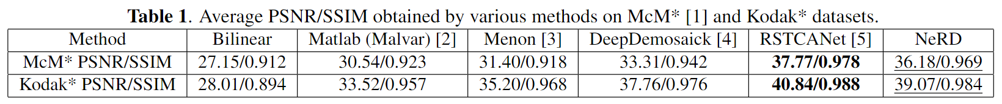
Comparison With Existing Methods
Original
Bilinear
Matlab
Menon
Kodak image (cropped)
Raw
DeepDemosaick
RSTCANet
NeRD

Slide 11
Conclusion
First neural field-based demosaicking!

Slide 12
Thank you for your attention
Tomas Kerepecky
kerepecky@utia.cas.cz
http://zoi.utia.cas.cz & www.kerepecky.eu

